Slide 1
SYSTEM MODEL AND GROUP COMMUNICATION

Slide 2
1. System Model Components
The architecture for managing replicated data involves three key components:
Replica Managers(RMs) : Hold physical copies (replicas) of logical objects (e.g., files, databases). Each RM ensures operations are applied atomically and deterministically (like a state machine).

Slide 3
1. System Model Components
• Front Ends (FEs): Act as intermediaries between clients and RMs. They hide replication details and forward client requests to RMs.
• Clients: Issue requests (read or update) to FEs, which route them to Rms.

Slide 4
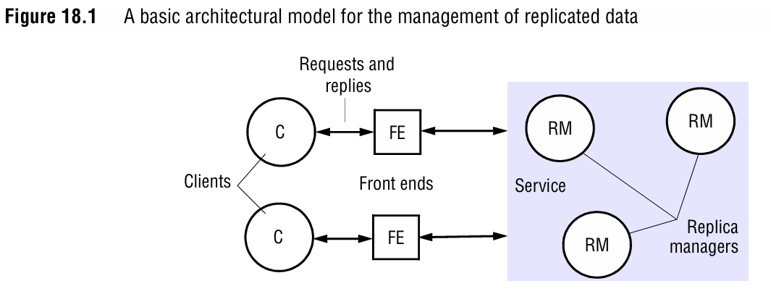
1. System Model Components

Slide 5
2.Request Handling Phases
When a client issues a request, the system follows five phases:
1. Request: The FE sends the request to one or more RMs (unicast or multicast).
2. Coordination: RMs agree on the request order:
  FIFO: Requests from the same client are processed in order.
  Causal: Preserves "happened-before" relationships.
  Total: All RMs process requests in the same global order.
3. Execution: RMs apply the operation (possibly tentatively).
4. Agreement: Consensus on committing/aborting the
operation (e.g., via two-phase commit).
5. Response: The FE returns results to the client.

Slide 6
3. Group Communication
Group communication ensures RMs coordinate to maintain consistency, especially during failures. Key concepts:
Group Membership: Dynamic groups where RMs can join/leave/crash.
View-Synchronous Communication: Ensures all members agree on group membership changes (views).
Properties of View-Synchronous Communication
1. Order: All processes deliver the same sequence of views.
2. Integrity: A process in a view always sees itself.
3. Non-Triviality: Eventually includes all reachable members.

Slide 7
4. Passive vs Active Replication
Passive (Primary-Backup) Replication
Primary RM: Handles all client requests. Backups stay idle.
Failover: If the primary crashes, a backup becomes the new primary.
Use Case: High consistency, lower performance due to single point of processing.

Slide 8
4. Passive vs Active Replication
Active Replication
All RMs Process Requests: Clients multicast requests to all RMs.
Total Ordering: Requests are processed in the same order at all RMs.
Use Case: High availability and fault tolerance (no single point of failure).

Slide 9
5. Role of Group Communication in Fault Tolerance
State Transfer: When a new RM joins, the group ensures it receives the current state. For example, the oldest RM sends a checkpoint, and others pause until the new member catches up.
Consensus: Group communication protocols (e.g., Paxos, Raft) help RMs agree on operations and membership changes.

Slide 10
5. Role of Group Communication in Fault Tolerance
Example of State Transfer:
New RM X joins the group.
The oldest RM A takes a snapshot of its state and sends it to X.
Other RMs pause processing until X integrates the state.
X signals readiness, and the group resumes operations.

Slide 11
6. Key Takeaways
System Model: RMs, FEs, and clients collaborate to manage replicated data. RMs behave as deterministic state machines.
Group Communication: Ensures consistent views and message ordering. View-synchronous protocols handle membership changes and failures.
Replication Strategies:
  Passive: Simplifies consistency but has a single point of failure.
  Active: Requires total ordering but provides high availability.

